Slide 1
Research Project Overview
By Not the Droids YOU ARE LOOKING FOR

Slide 2
About Us
Not the Droids You Are Looking For is a 7th year team from Pittsburgh, PA
Our research project for Trash Trek was a Global Innovation Award semi-finalist project (Top 20/29,0000).
Our research project in Nature’s Fury won Innovative Solution at the FIRST LEGO League International Open in Toronto.
Our research project for World Class was EV3Lessons.com! ;-)

Slide 3

What is the Research Project?
A group research project related to the year’s theme
Come up with an innovative solution to a real-world problem
Themes:
2011: Food Factor (food safety)
2012: Senior Solutions (senior citizens)
2013: Nature’s Fury (natural disasters)
2014: World Class (education)
2015: Trash Trek (garbage)
2016: Animal Allies (animals)
2017: Hydro Dynamics (water)

Slide 4
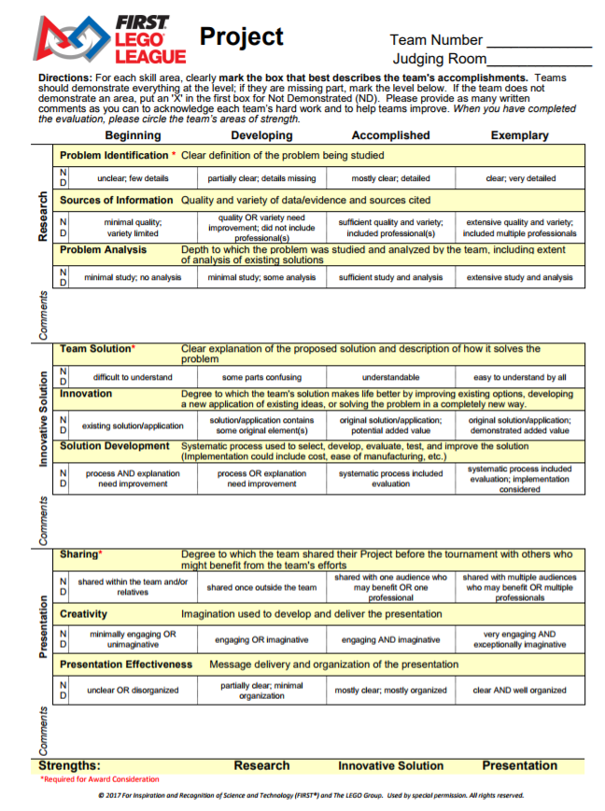
New Rubrics for 2017
Research
Identify a problem and analyze existing solutions
Innovative Solution
Develop a solution to your problem and understand what it would take to implement this idea.
Presentation
Share your project with people/organizations
Create an effective presentation for judges

Slide 5
Project Process
Identify a Problem
Background Research
Innovative Solution
Develop Prototype
Sharing/
Presentation
Research
Innovative Solution
Sharing
Look for lessons on each of these topics on EV3Lessons.com

Slide 6
SAMPLE PROJECTS
2011: Food Factor (food safety)
Detecting spoilt milk
2012: Senior Solutions (senior citizens)
Helping seniors remember where they left their processions
2013: Nature’s Fury (natural disasters)
An early-warning ash detection system for airplanes
2014: World Class (education)
A better way to learn to program the EV3 (EV3Lessons.com)
2015: Trash Trek (garbage)
A more efficient way to recycle batteries (InvisiSort)
2016: Animal Allies (animals)
Bats getting killed by wind turbines

Slide 7

Credits
This lesson was written by Sanjay and Arvind Seshan
More lessons available at www.ev3lessons.com

